Slide 1
B-Tree
Pro Academy I
Data Structure
Notes:
By leonardi.l

Slide 2
Definition
Self balancing tree (like RBT or AVL) with short height
Data retrieved in blocks, to minimize disk access
Designed for databases and filesystems

Slide 3
Properties
All leaves are at same level.
Has minimum degree (t). t = disk block size.
Every node except root must contain at least t-1 keys.
Root may contain minimum 1 key.
All nodes (including root) may contain at most 2t – 1 keys.
Number of children of a node is equal to the number of keys in it plus 1.
All keys of a node are sorted in increasing order.
The child between two keys k1 and k2 contains all keys in range from k1 and k2.
B-Tree grows and shrinks from root

Slide 4
Constructor
class BTreeNode
{
int *keys; // An array of keys
int t; // Minimum degree
BTreeNode **C; // An array of child pointers
int n; // Current number of keys
bool leaf; // Is true when node is leaf
public:
BTreeNode(int _t, bool _leaf); // Constructor
// A function to traverse all nodes
// in a subtree rooted with this node
void traverse();
// A function to search a key in subtree
// rooted with this node.
BTreeNode *search(int k);
// returns NULL if k is not present.
// Make BTree friend of this so that we can access
// private members of this class in BTree functions
friend class BTree;
};
// A BTree
class BTree
{
BTreeNode *root; // Pointer to root node
int t; // Minimum degree
public:
// Constructor (Initializes tree as empty)
BTree(int _t)
{ root = NULL; t = _t; }
// function to traverse the tree
void traverse()
{ if (root != NULL) root->traverse(); }
// function to search a key in this tree
BTreeNode* search(int k)
{ return (root == NULL)? NULL : root->search(k); }
};

Slide 5
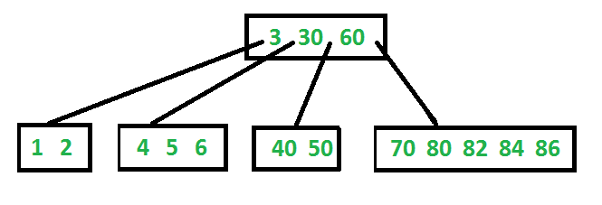
Structure
Following is an example B-Tree of minimum degree 3.
In practical B-Trees, the value of minimum degree is much more than 3.

Slide 6
B-Tree : Search & Traverse
Search Search is similar to search in Binary Search Tree. Let the key to be searched be k. We start from root and recursively traverse down. For every visited non-leaf node, if the node has key, we simply return the node. Otherwise we recur down to the appropriate child (The child which is just before the first greater key) of the node. If we reach a leaf node and don’t find k in the leaf node, we return NULL.
Traverse Traversal is also similar to Inorder traversal of Binary Tree. We start from the leftmost child, recursively print the leftmost child, then repeat the same process for remaining children and keys. In the end, recursively print the rightmost child.

Slide 7
B-Tree : Insert
Initialize x as root.
While x is not leaf, do following
Find the child of x that is going to to be traversed next. Let the child be y.
If y is not full, change x to point to y.
If y is full, split it and change x to point to one of the two parts of y. If k is smaller than mid key in y, then set x as first part of y. Else second part of y. When we split y, we move a key from y to its parent x.
The loop in step 2 stops when x is leaf. x must have space for 1 extra key as we have been splitting all nodes in advance. So simply insert k to x.

Slide 8
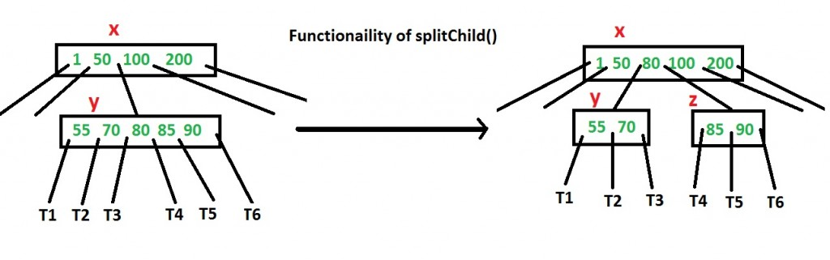
B-Tree : Splitting
How to make sure that a node has space available for key before the key is inserted? We use an operation called splitChild()
child y of x is being split into two nodes y and z. Note that the splitChild operation moves a key up and this is the reason B-Trees grow up unlike BSTs which grow down.

Slide 9

B-Tree : Insert
Example : B-Tree minimum degree = 3
Inserted Sequence : 10, 20, 30, 40, 50, 60, 70, 80 and 90
Initially, the B-Tree is empty
First, insert 10 :

Slide 10

B-Tree : Insert
Now, insert 20, 30, 40 and 50.
all will be inserted in root because maximum number of keys a node can accommodate is 2*t – 1 which is 5.

Slide 11
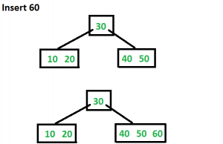
B-Tree : Insert
Next, insert 60
Since root is full, it will split into two then 60 will be inserted into the appropriate child

Slide 12
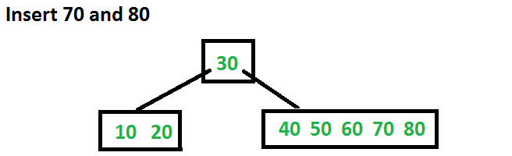
B-Tree : Insert
Next, insert 70 and 80
Both goes to appropriate leaf without split

Slide 13
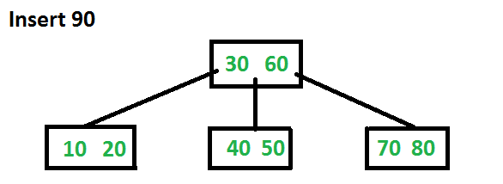
B-Tree : Insert
Last, insert 90
It goes to the right leaf, which is full
Causing another split to happens
The middle key (60) will go up to the parent

Slide 14
B-Tree : Delete
If the key k is in node x and x is a leaf, delete the key k from x.
If the key k is in node x and x is an internal node, do the following.
If the child y that precedes k in node x has at least t keys, then find the predecessor k0 of k in the sub-tree rooted at y. Recursively delete k0, and replace k by k0 in x. (We can find k0 and delete it in a single downward pass.)
If y has fewer than t keys, then, symmetrically, examine the child z that follows k in node x. If z has at least t keys, then find the successor k0 of k in the subtree rooted at z. Recursively delete k0, and replace k by k0 in x. (We can find k0 and delete it in a single downward pass.)
Otherwise, if both y and z have only t-1 keys, merge k and all of z into y, so that x loses both k and the pointer to z, and y now contains 2t-1 keys. Then free z and recursively delete k from y.
If the key k is not present in internal node x, determine the root x.c(i) of the appropriate subtree that must contain k, if k is in the tree at all. If x.c(i) has only t-1 keys, execute step 3a or 3b as necessary to guarantee that we descend to a node containing at least t keys. Then finish by recursing on the appropriate child of x.
If x.c(i) has only t-1 keys but has an immediate sibling with at least t keys, give x.c(i) an extra key by moving a key from x down into x.c(i), moving a key from x.c(i) ’s immediate left or right sibling up into x, and moving the appropriate child pointer from the sibling into x.c(i).
If x.c(i) and both of x.c(i)’s immediate siblings have t-1 keys, merge x.c(i) with one sibling, which involves moving a key from x down into the new merged node to become the median key for that node.
Notes:
Since most of the keys in a B-tree are in the leaves, deletion operations are most often used to delete keys from leaves. The recursive delete procedure then acts in one downward pass through the tree, without having to back up. When deleting a key in an internal node, however, the procedure makes a downward pass through the tree but may have to return to the node from which the key was deleted to replace the key with its predecessor or successor (cases 2a and 2b).

Slide 15
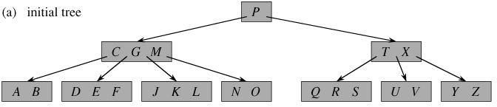
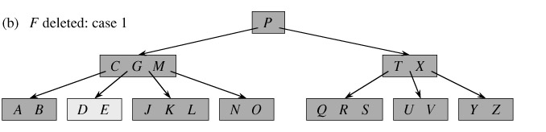
B-Trees : Delete
If the key k is in node x and x is a leaf, delete the key k from x.

Slide 16
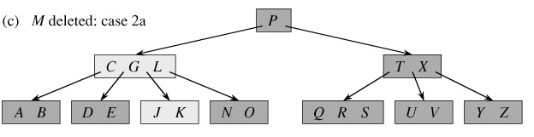
B-Trees : Delete
If the key k is in node x and x is an internal node, do the following.
If the child y that precedes k in node x has at least t keys, then find the predecessor k0 of k in the sub-tree rooted at y. Recursively delete k0, and replace k by k0 in x. (We can find k0 and delete it in a single downward pass.)
If y has fewer than t keys, then, symmetrically, examine the child z that follows k in node x. If z has at least t keys, then find the successor k0 of k in the subtree rooted at z. Recursively delete k0, and replace k by k0 in x. (We can find k0 and delete it in a single downward pass.)

Slide 17
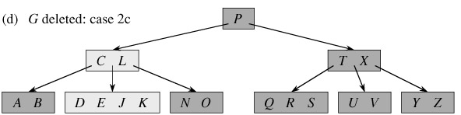
B-Trees : Delete
2. If the key k is in node x and x is an internal node, do the following.
c) Otherwise, if both y and z have only t-1 keys, merge k and all of z into y, so that x loses both k and the pointer to z, and y now contains 2t-1 keys. Then free z and recursively delete k from y.

Slide 18
Speed
Algorithm | Average | Worst Case
Space | O(n) | O(n)
Search | O(log n) | O(log n)
Insert | O(log n) | O(log n)
Delete | O(log n) | O(log n)

Slide 19
Applications of B-Tree
Databases
Filesystems

